Slide 1
Identification of the sentiments and emotions of stressful tweets on Twitter during the COVID-19 pandemic
Web Mining (BIA-660) Fall 2021
Instructor: Prof. Jingyi Sun
Team Members: Abdul Razzak Moulvi, Deepanshu Negi, Shreeya Kokate, Rishi Singh

Slide 2
Introduction
During the current time of post-COVID-19, many people have started to go back to their normal lives pre-covid.
The pandemic has also seen a rise in the mental health problems people have been facing as ‘4 in 10 adults in the US may face problems related to depression and anxiety (Panchal, Kamal, Cox, & Garfield, 2021).
Hence due to the increase in social media activity and the rise in mental health problems specifically related to stress the project aims to identify the sentiments and emotions behind new tweets related to stress. Along with identifying the source of a tweet by predicting whether a tweet has been posted by a bot/third-party sources rather than a user.
This research is aimed to help social media companies gain insights of mental health in their consumer domain specifically related to stress and to help future researchers identify tweets that may have been from tweeted by bots/third-party sources or a user when web scraping data.

Slide 3
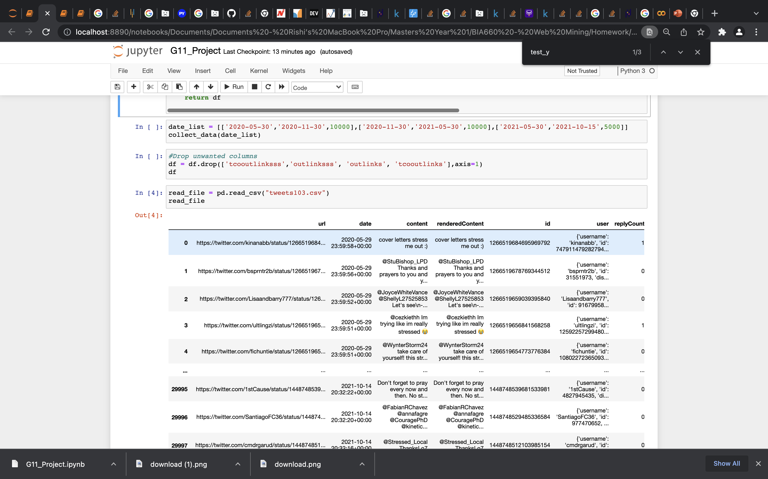
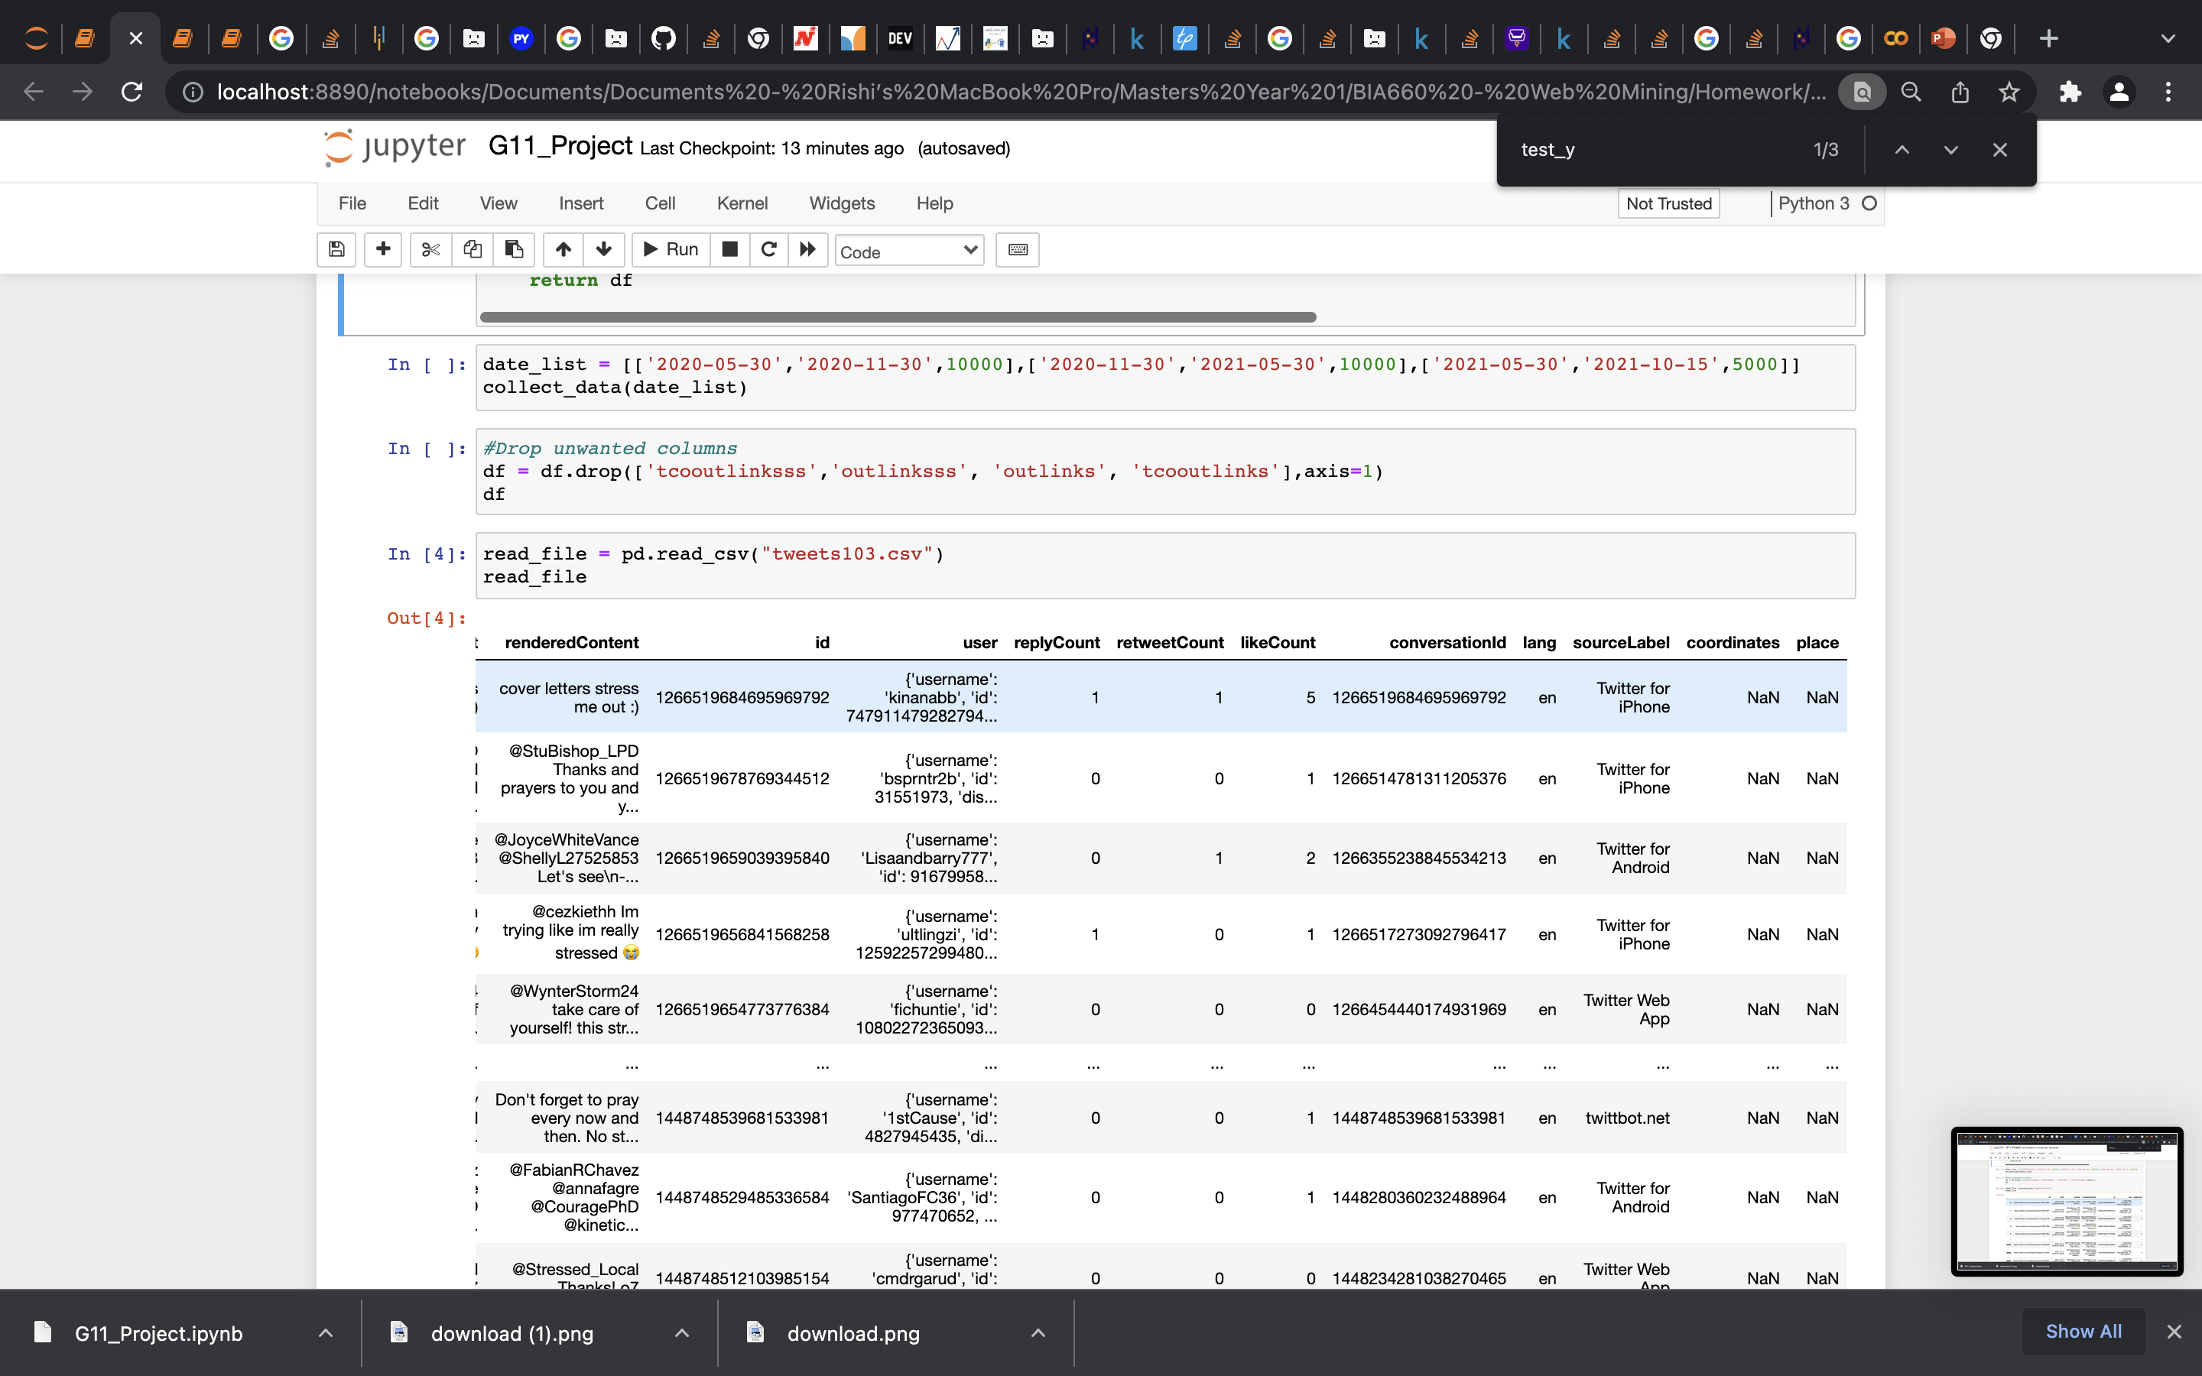
Data scraping & Data Cleaning
Scraped data using the snscrape API - https://github.com/JustAnotherArchivist/snscrape
Sampling of data between a timeframe of 30th October 2019 – 15th October 2021
Keyword used for this project was 'stress' for the retrieval of data.
From our search we were able to gather a total of 30000 tweets with 14 columns.

Slide 4
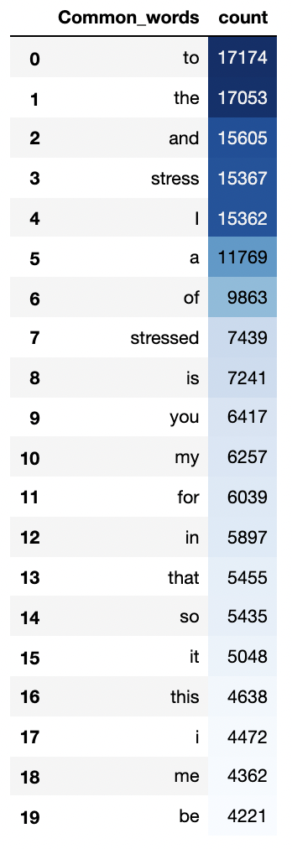
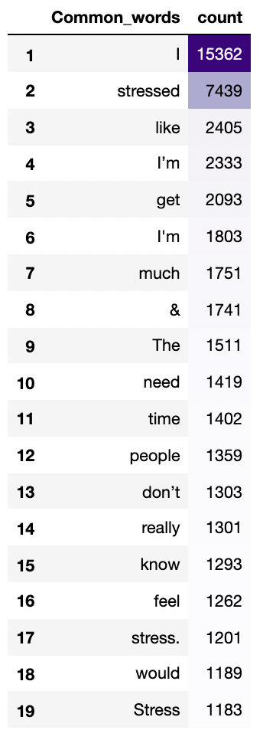
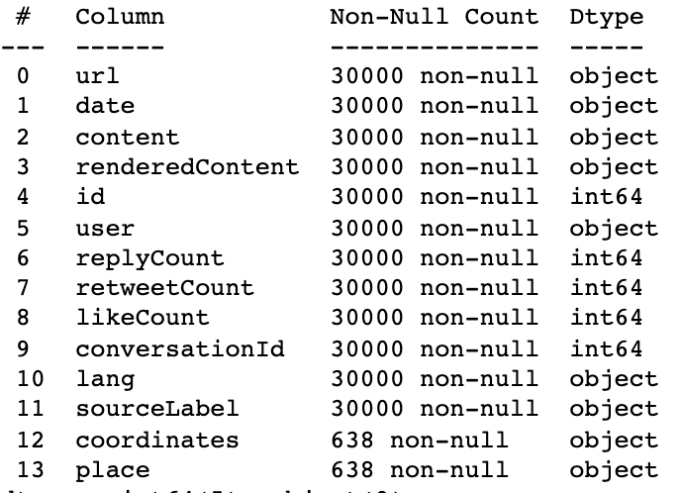
EDA - Data

Slide 5
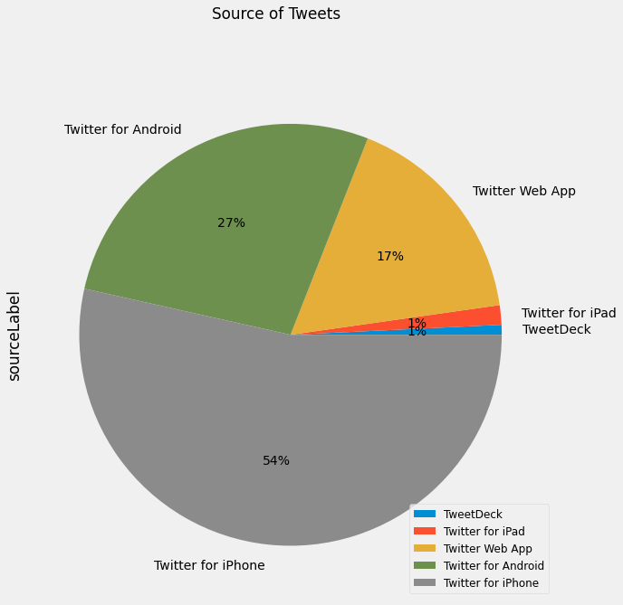
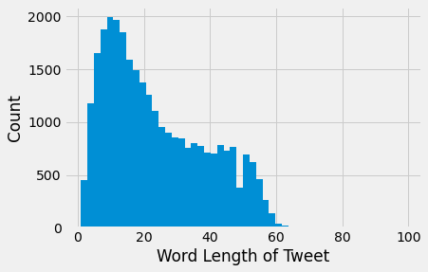
EDA – sourceLabel
Total Sources = 342
Top five sources: 28115/30k

Slide 6
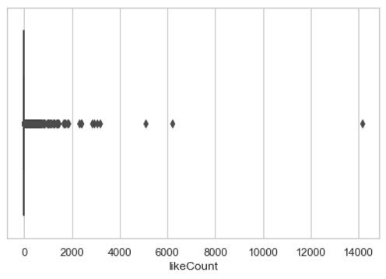
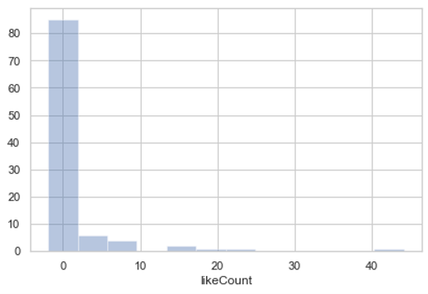
EDA for like Count
Total tweets
For 100 tweets

Slide 7
Data Preprocessing
Cleaning the text
Tokenization
Emoji Handling
POS tagging
(word, tag)
Lemmatization
Stop words removal

Slide 8



Unsupervised Sentimental Analysis
Measures
TextBlob
Sentiments
Polarity
-1
1
Subjectivity
0
1

Slide 9
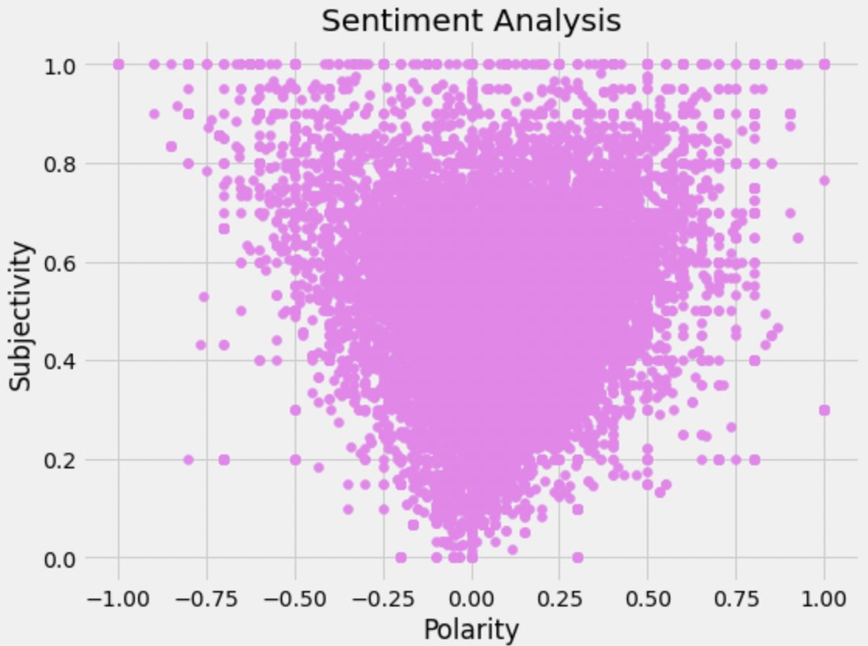
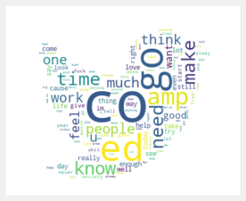
Lemma Text

Slide 10
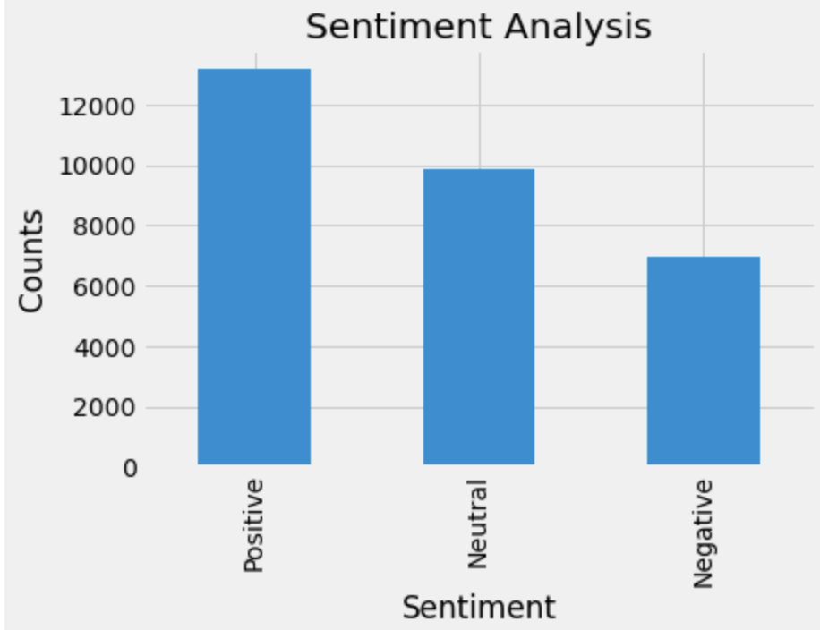
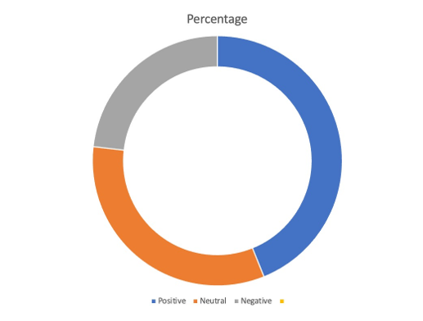
23.2%
43.9%
32.9%

Slide 11
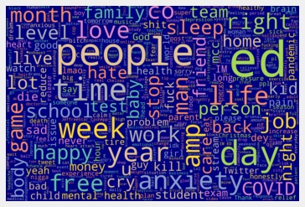
Medical Words
Extracted biomedical words from all the tweets text using en_core_sci_md package. Which is a spaCy pipeline for biomedical data which contains 50k word vectors.

Slide 12
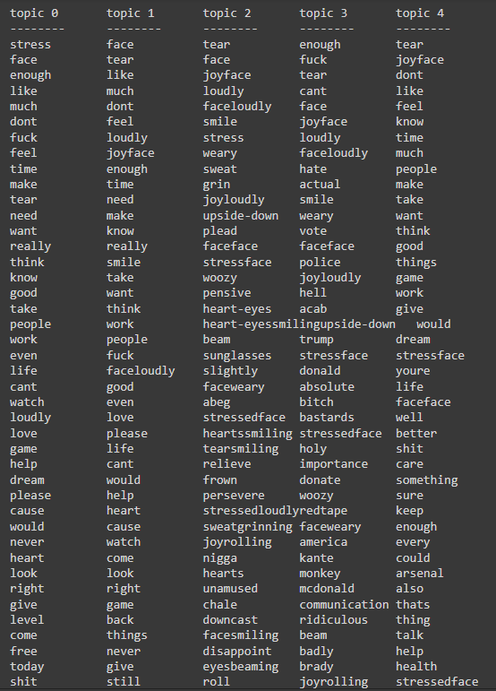
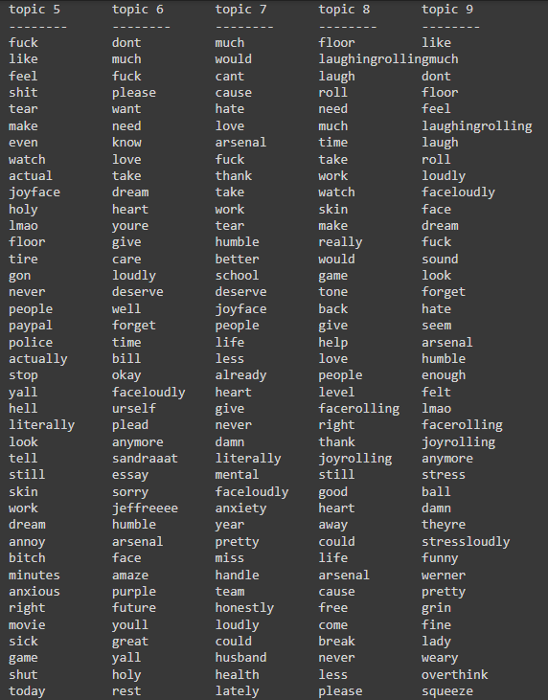
Topic Modelling
Topic modelling provides us with methods to organize, understand and summarize large collections of textual information. It helps in discovering hidden topical patterns that are present across the collection.

Slide 13
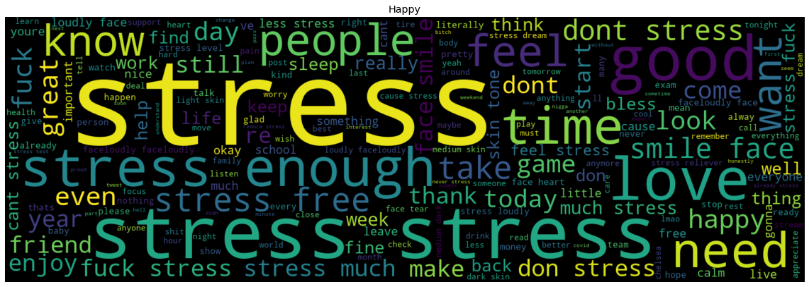
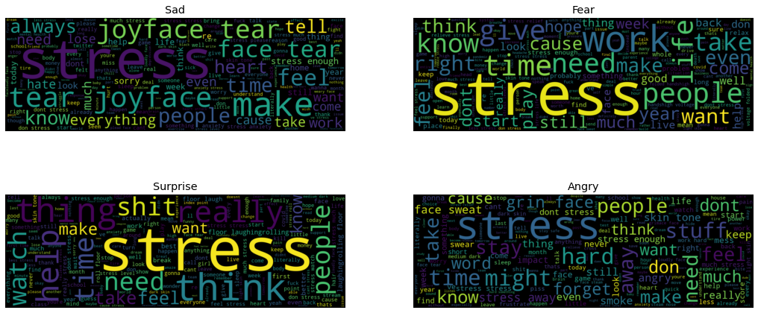
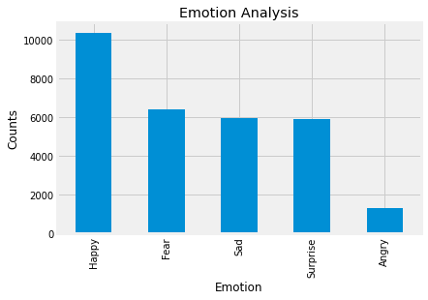
Emotional Analysis
Emotion analysis is the process of identifying and analyzing the underlying emotions expressed in textual data

Slide 14
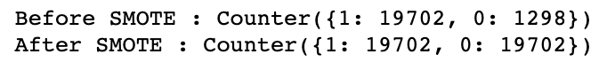
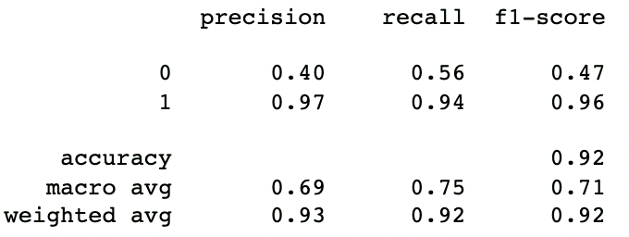
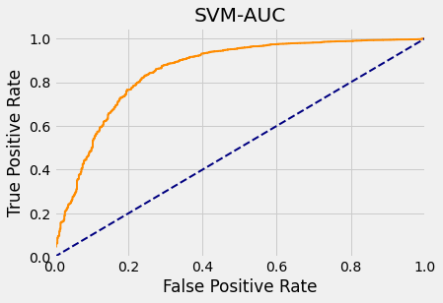
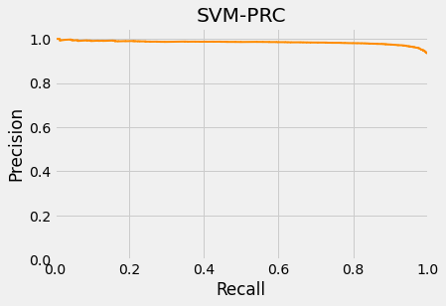
Binary classification of original source of tweets
• Synthetic Minority Oversampling Technique (SMOTE).
• Oversampling the minority class.
• This can method duplicates examples from the minority class prior to the fitting of the model.

Slide 15
Future Work
Better choice of keyword instead of stress to narrow down the content for sentimental analysis and emotional analysis.
Use of more machine learning algorithms to compare accuracy.
Larger collection of tweets from bots.
Search for more data with human coding of a stress label on tweets in prospects of creating a machine learning model to classify tweets in regard to tweets.

Slide 16
Conclusion
We were able to use an unsupervised learning approach to gather the sentiments behind the tweets. Along with this, we were able to conduct emotional analysis on the data and extract the emotions behind the tweets.
Implemented a SVM model to classify whether a tweet is from a bot/other third-party sources or a user using an iPad/iPhone/Android/Web app device.

Slide 17
Thank you

Slide 18
References
https://github.com/JustAnotherArchivist/snscrape
https://monkeylearn.com/sentiment-analysis/
https://www.kff.org/coronavirus-covid-19/issue-brief/the-implications-of-covid-19-for-mental-health-and-substance-use/view/footnotes/
https://towardsdatascience.com/topic-modeling-and-latent-dirichlet-allocation-in-python-9bf156893c24
https://www.researchgate.net/publication/338013006_Classification_of_AI_Powered_Social_Bots_on_Twitter_by_Sentiment_Analysis_and_Data_Mining_through_SVM

